Slide 2
String Functions and Operations

Slide 3
What Is String?
A string is a data type used in programming, such as an integer and floating point unit, but is used to represent text rather than numbers. It is comprised of a set of characters that can also contain spaces and numbers. For example, the word "hamburger" and the phrase "I ate 3 hamburgers" are both strings. Even "12345" could be considered a string, if specified correctly. Typically, programmers must enclose strings in quotation marks for the data to recognized as a string and not a number or variable name.
String is a collection of characters.
String is a collection of ASCII characters.

Slide 4
PHP chr() Function
The chr() function returns a character from the specified ASCII value.
Syntax
chr(ascii)
Example
<?php
echo chr(65);
echo chr(122);
?>

Slide 5
PHP ord() Function
The ord() function returns the ASCII value of the first character of a string.
Syntax
ord(string)
Example
<?php
echo ord(“h”).”<br />”;
echo ord(“hello”).”<br />”;
?>

Slide 6
PHP strlen() Function
The strlen() function is used to return the length of a string.
Syntax
strlen(string)
Example
<?php
echo strlen("Hello world!");
?>

Slide 7
PHP substr() Function
The substr() function returns a part of a string.
Syntax
substr(string,start,length)
Example
<?php
echo substr("Hello world!",6);
echo substr("Hello world!",6,5);
?>

Slide 8
PHP trim() Function
The trim() function removes whitespaces from both sides of a string.
Syntax
trim(string)
Example
<?php
echo trim(“ Hello World ”);
?>

Slide 9
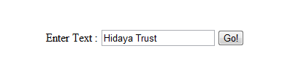
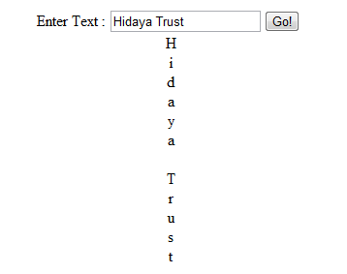
Assignment # 1
Enter String Text
Click
Output

Slide 10

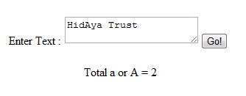
Assignment # 2
Enter String Text
Click
Output

Slide 11
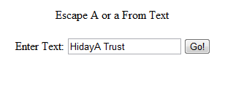
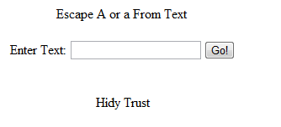
Assignment # 3
Click
Enter String Text
Output

Slide 12
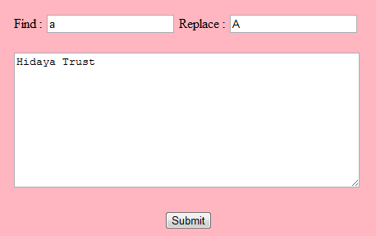

Assignment # 4
Find character
Replace character
Enter some text here
Click
Output

Slide 13
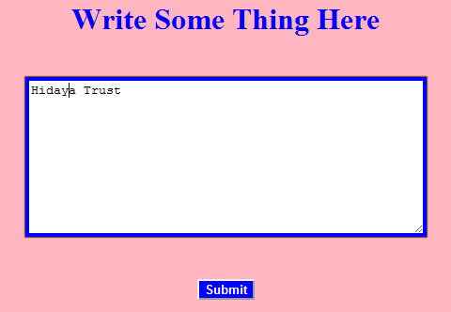
Assignment # 5
Enter Text
Click

Slide 14

Assignment # 5
Output

Slide 15
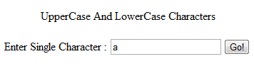
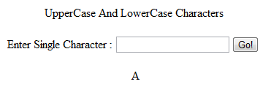
Assignment # 6
Click
Character
Output

Slide 16

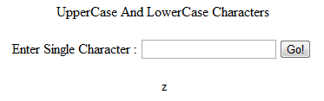
Assignment # 6
Click
Character
Output

Slide 17
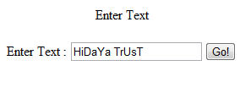
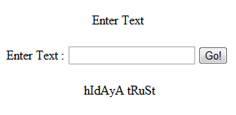
Assignment # 7
Enter Text
Click
Output

Slide 18
PHP rand() Function
The rand() function generates a random integer.
If this function is called without parameters, it returns a random integer between 0 and RAND_MAX.
If you want a random number between 10 and 100 (inclusive), use rand (10,100).
Note: On some platforms (such as Windows) RAND_MAX is only 32768. So, if you require a range larger than 32768, you can specify min and max, or use the mt_rand() function instead.
The other random function, mt_rand() function generates a better random value than this function .

Slide 19
PHP rand() Function continue……
Syntax
rand(min,max)
Example 1
<?php
echo(rand() . "<br />");
echo(getrandmax(). "<br />");
echo(rand(10,100));
?>

Slide 20
PHP rand() Function continue……
Example 2
<?php
echo "<hr> mt_rand = ".mt_rand()."<hr>";
echo "<hr>rand = ".rand()."<hr>";
echo "<hr> mt_rand with range = ".mt_rand(1,100)."<hr>";
echo "<hr> rand with range = ".rand(1,100)."<hr>";
?>

Slide 21
PHP round() function
The round() function rounds a number to the nearest integer.
Syntax:
round(x,prec)
Parameter | Description
x | Required. The number to be round
prec | Optional. The number of digits after the decimal point

Slide 22
PHP round() function continued….
Example 1
<?php
echo round(1.68) ;
?>
Example 2
<?php
echo round(1.68,1) ;
?>

Slide 23
PHP ceil() function
The ceil() function returns the value of a number rounded UPWARDS to the nearest integer.
Syntax
Ceil(x)
Example:
<?php
echo ceil(0.60);
?>

Slide 24
PHP floor() Function
The floor() function returns the value of a number rounded DOWNWARDS to the nearest integer.
Syntax
floor(x)
Example:
<?php
echo floor(0.60);
?>

Slide 25
PHP explode() Function
The explode() function breaks a string into an array.
Syntax
explode(separator,string)
Example
<?php
$string = "Hello world. It's a beautiful day.";
print_r (explode(" ",$string));
?>

Slide 26
PHP implode() Function
The implode() function returns a string from the elements of an array.
Syntax
implode(separator,array)
Example
<?php
$array = array('Hello','World!','Beautiful','Day!');
echo implode(" ",$array);
?>

Slide 27
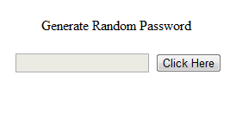
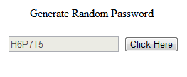
Assignment # 8
Disabled Textbox
Click Generate Password
Output

Slide 28


Assignment # 9
Enter Word
Click
Output

Slide 29

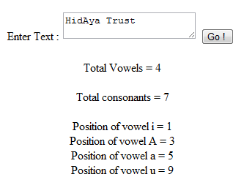
Assignment # 10
Enter Text
Click
Output

Slide 30
PHP ucfirst() Function
The ucfirst() function converts the first character of a string to uppercase.
Syntax
ucfirst(string)
Example
<?php
echo ucfirst("hello world");
?>

Slide 31
PHP ucwords() Function
The ucwords() function converts the first character of each word in a string to uppercase
Syntax:
ucwords(string)
Example:
<?php
echo ucwords("hello world");
?>

Slide 32
PHP strtolower() Function
The strtolower() function converts a string to lowercase.
Syntax:
strtolower(string)
Example:
<?php
echo strtolower("Hello WORLD.");
?>

Slide 33
PHP strtoupper() Function
The strtoupper() function converts a string to lowercase.
Syntax:
strtoupper(string)
Example:
<?php
echo strtoupper(“hello world.");
?>

Slide 34

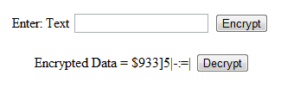
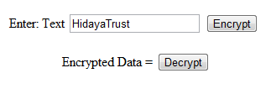
Assignment # 11
Enter Text
Encrypt Text
Encrypted Data
Decrypt Text
Output

Slide 35
PHP hash_algos() Function
hash_algos — Return a list of registered hashing algorithms
Syntax
array hash_algos ()
Example
<?php
print_r(hash_algos());
?>

Slide 36
PHP md5() Function
The md5() function calculates the MD5 hash of a string.
This function returns the calculated MD5 hash on success, or FALSE on failure.
Syntax
md5(string)
Example
<?php
$string = "Hello";
echo md5($string);
?>

